Slide 1
PMS Road image on STATIC MAP (WPF)
2024.08.31
김 상 현
GPR 사업부 / 기술연구소
이성 주식회사

Slide 2
목차

Slide 3
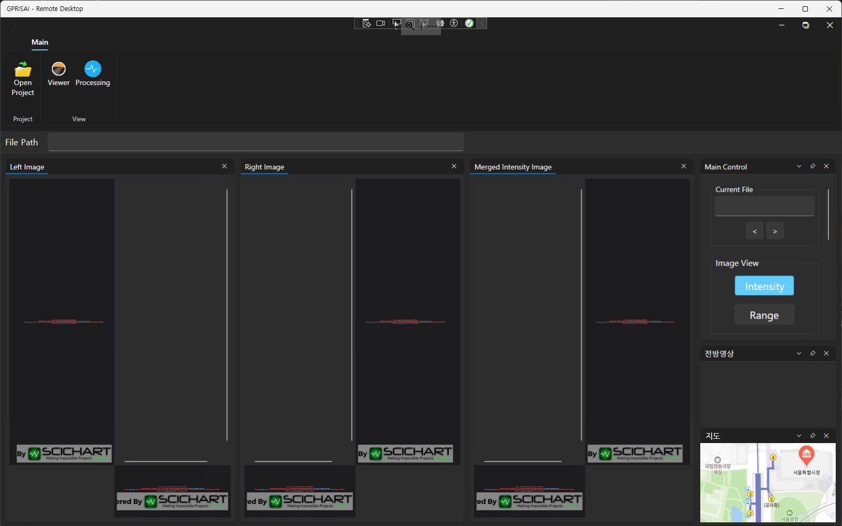
PMS road image on Static map
GPR/PMS 프로그램 NAVER Dynamic map 사용중
Static map 사용이 Naver Map service 덜 요청하고, 데이터에 따른 위치 표시등이 수월할 것으로 예상됨

Slide 4
PMS road image on Static map
Repo: https://github.com/gpris/nmapgprviewer (private)

Slide 5
Checklists
□/√ (Not done/Done)
□ WPF로 Naver Static Map표시
□ Lat/Lng로 Static map상의 위치표시
□ Line draw (Two GPS points)
□ PMS bitmap drawing
□ Rotating bitmap image base on two points src to dst
□ Road image(4m x 10m) draw based on zoom level
□ Static map zoom level study get scale factors
□ Draw one line of image based on direction of GPS path.

Slide 6
Zoom Scale factors
Zoom Level | Pixels per 1 meter | Road image (w x h px) | Scaled Road image ratio
14 | 0.25px | 1 x 2.5 | 1/4000
15 | 0.5px | 2 x 5 | 1/2000
16 | 1px | 4 x 10 | 1/1000
17 | 2px | 8 x 20 | 1/500
18 | 4px | 16 x 40 | 1/250
19 | 8px | 32 x 80 | 1/125
20 | 16px | 64 x 160 | 1/62.5

